Slide 1
Python Dictionaries
and Files
February 2026

Slide 2
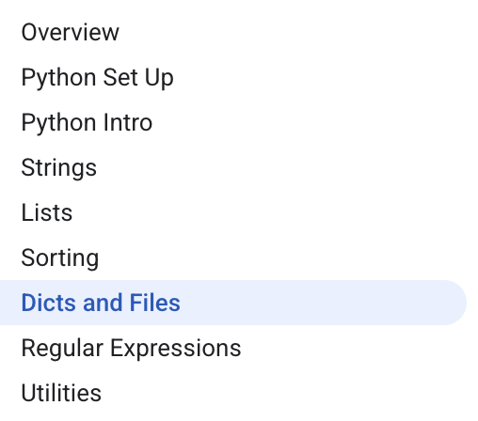
Curriculum Checkpoint
Keep going!
Almost there!

Slide 3
Dict Hash Table

Slide 4
Dictionaries in Python
• A Python dictionary, called a dict, stores information as key/value pairs so you can quickly find a value later by using its key.
◦ Often described as a hash table
◦ Designed for fast lookups and updates
• You can think of a dict like a labeled cabinet where each label (the key) points to a stored item (the value) without searching sequentially.
◦ Keys act like names
◦ Values hold the associated data
• Dicts are especially useful when your data arrives in a scattered order, because you can organize it immediately into a structure that is easy to query.
◦ Great for grouping, counting, and indexing

Slide 5
Creating Dictionaries and Choosing Keys and Values
• A dictionary literal is written with braces containing key:value pairs, such as {'a': 1, 'b': 2}, and an empty dictionary is simply {}.
◦ Braces { } indicate a dict
◦ Pairs use a colon between key and value
• Dictionary keys should be immutable types like strings, numbers, or tuples, because keys must stay stable so the dictionary can reliably find them later.
◦ Strings and tuples are common keys
◦ Values can be any Python type
• You can build a dictionary gradually by starting with {} and then assigning new key/value pairs using square brackets as you discover or compute new data.
◦ Pattern: d[key] = value
◦ Useful while reading files or processing input

Slide 6
Looking Up Values Safely: Brackets, in, and get()
• To retrieve or set a value in a dict you use square brackets, so d['foo'] looks up the value under the key 'foo' and d['foo'] = 7 updates it.
◦ Same syntax works for reading and writing
◦ Updates overwrite existing values
• If you try to look up a key that is not present, Python raises a KeyError, so you should check membership before indexing when a key might be missing.
◦ Membership test: 'k' in d
◦ Avoids unexpected crashes
• The method d.get(key) returns the value when the key exists, and returns None when it does not, while d.get(key, default) lets you choose the fallback.
◦ No KeyError when missing
◦ Custom default value is optional

Slide 7
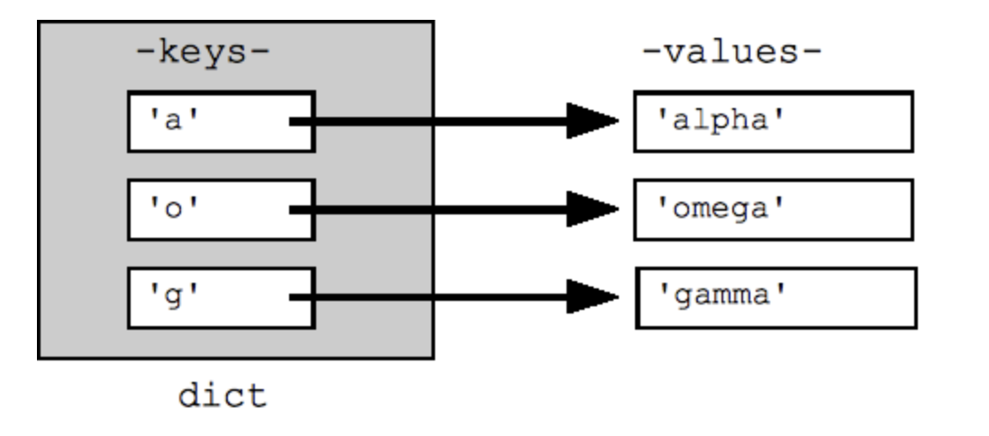
Code Example: Building a Dictionary
## Can build up a dict by starting with the empty dict {}
## and storing key/value pairs into the dict like this:
## dict[key] = value-for-that-key
dict = {}
dict['a'] = 'alpha'
dict['g'] = 'gamma'
dict['o'] = 'omega'
print(dict) ## {'a': 'alpha', 'o': 'omega', 'g': 'gamma'}

Slide 8
Code Example: Accessing a Dictionary
print(dict['a']) ## Simple lookup, returns 'alpha'
dict['a'] = 6 ## Put new key/value into dict
'a' in dict ## True
print(dict['z']) ## Throws KeyError
if 'z' in dict: print(dict['z']) ## Avoid KeyError
print(dict.get('z')) ## None (instead of KeyError)

Slide 9
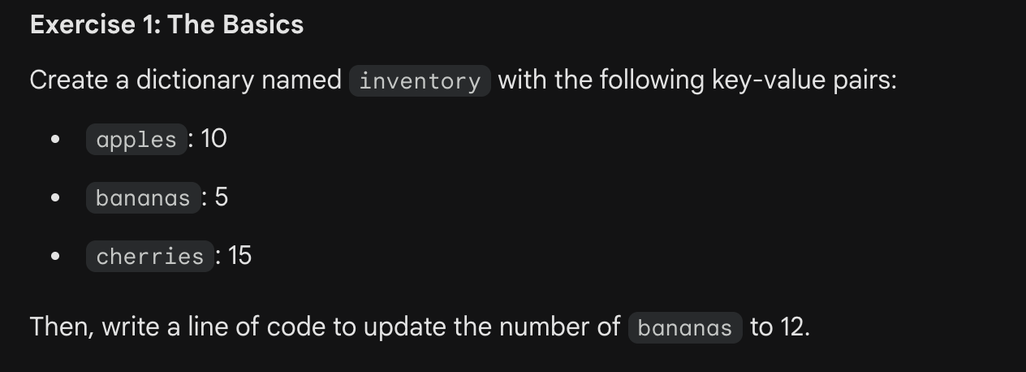
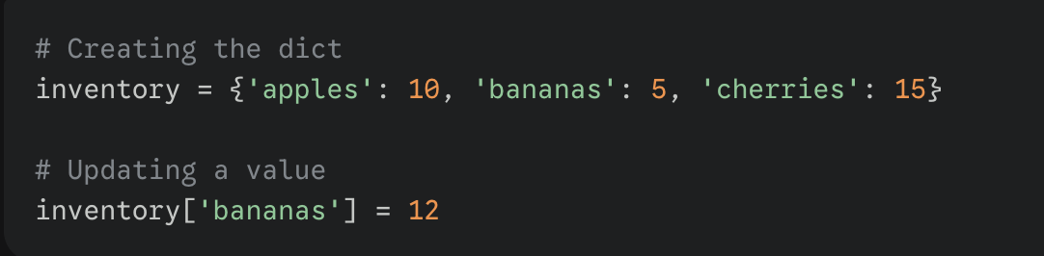

Slide 10
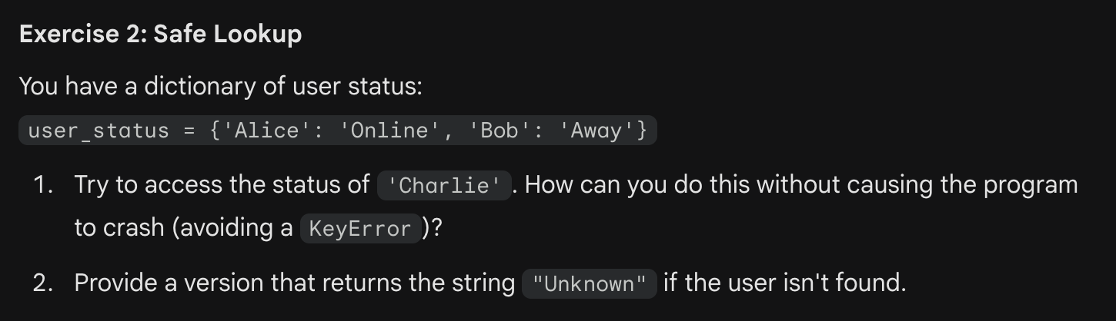
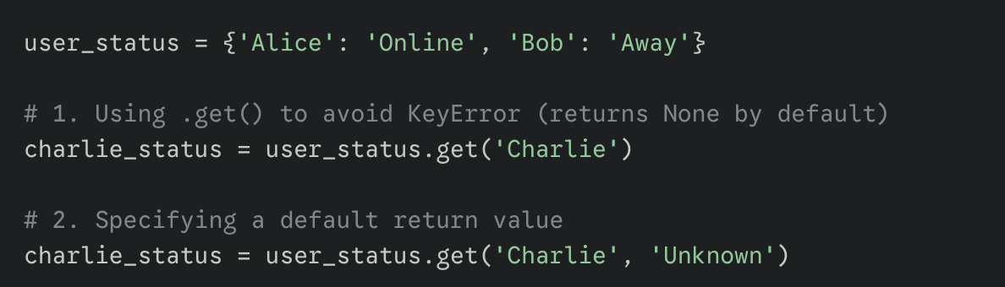

Slide 11
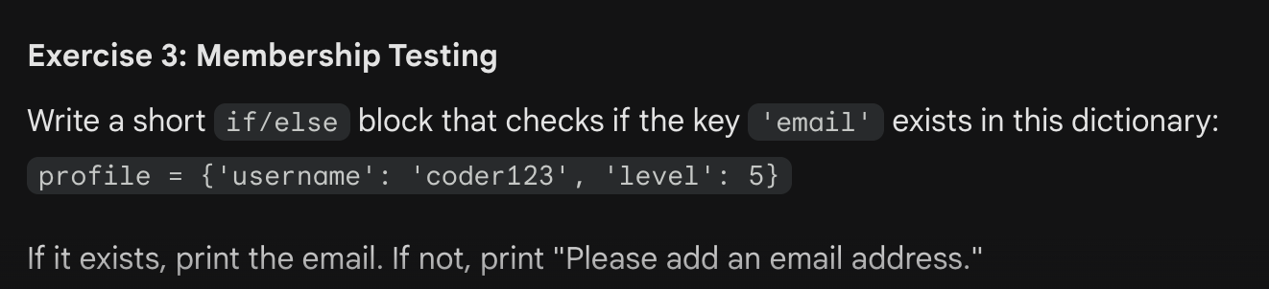
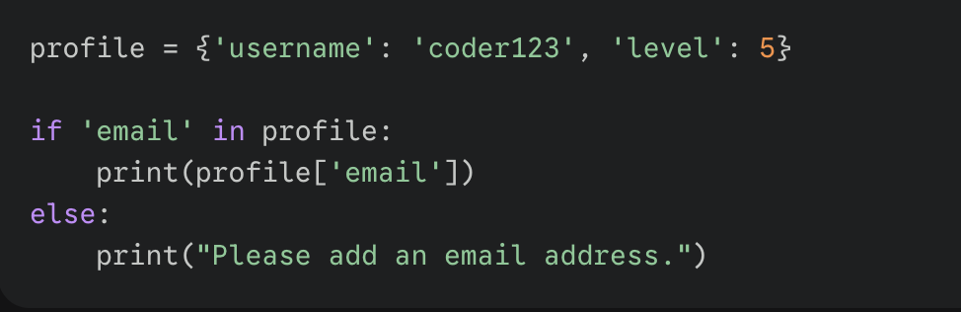
profile = {'username': 'coder123', 'level': 5}

Slide 12
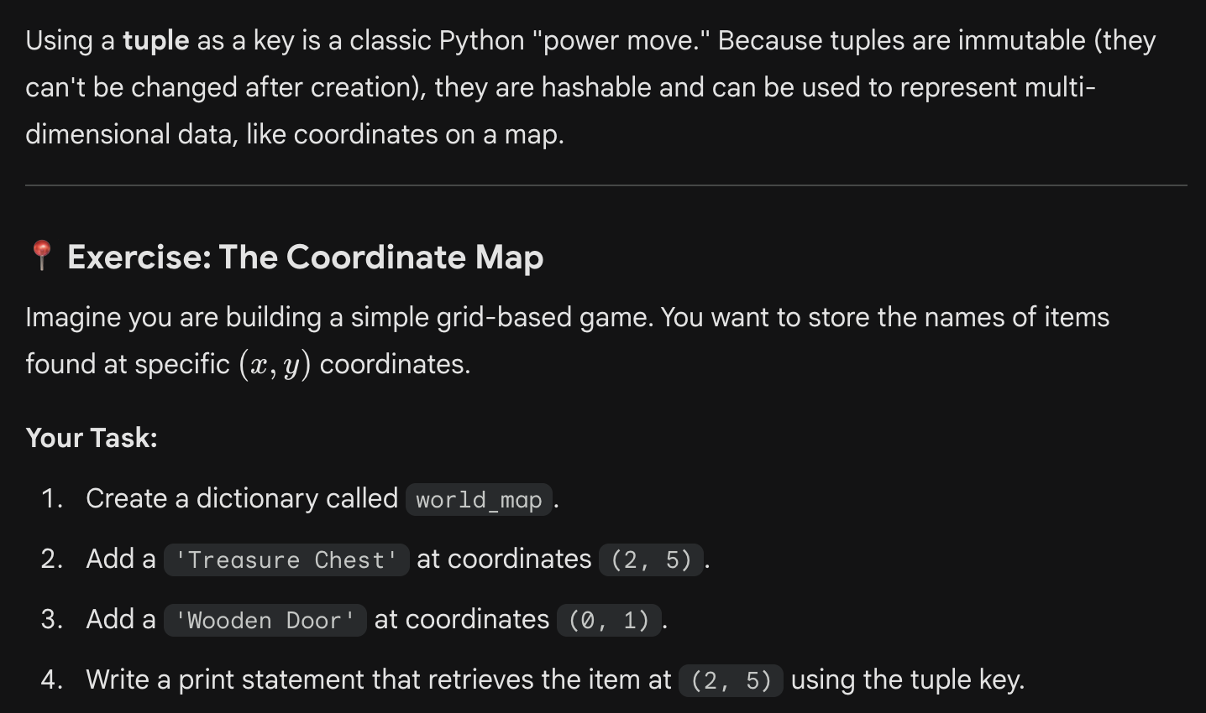
Answer on next slide

Slide 13
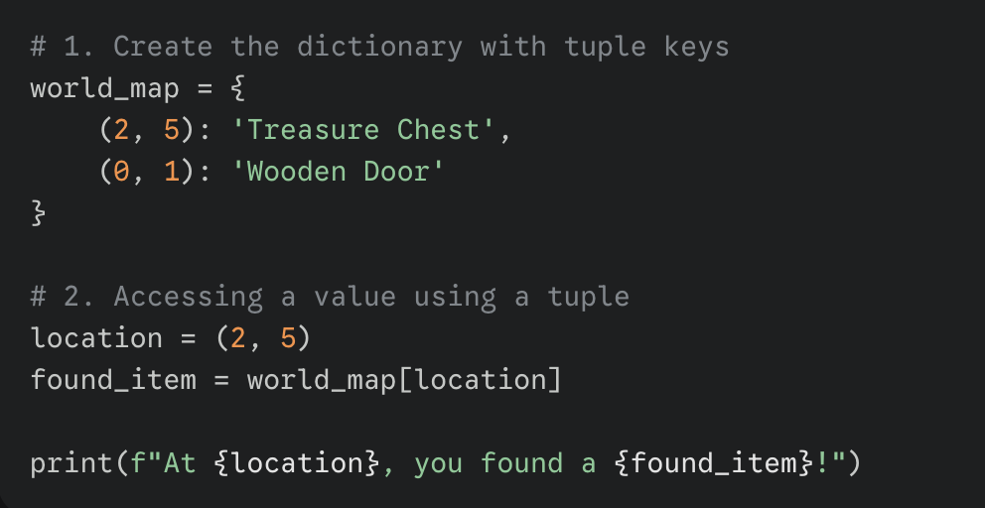
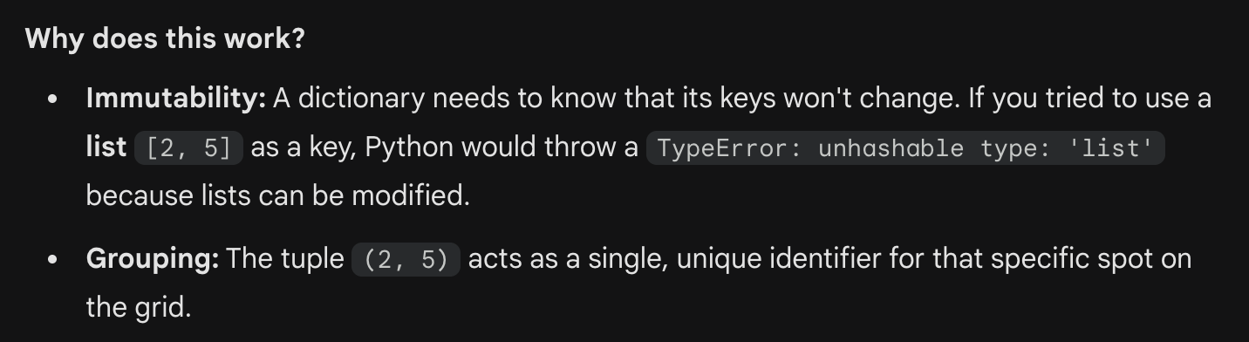

Slide 14
Looping Through a Dictionary: Iterate over Keys
• A for loop over a dictionary iterates over the keys by default, which means for key in d gives you keys you can use to look up each value.
◦ Default iteration returns keys
◦ Common pattern: d[key]
• The order of keys during iteration should be treated as arbitrary in this context, so you should not rely on the printed order to mean anything important.
◦ Order can vary
◦ Sort when you need consistent output

Slide 15
Looping Through a Dictionary: Keys, Values, and Items
The methods d.keys() and d.values() provide explicit views of all keys or all values, while d.items() provides key/value pairs for efficient full inspection.
◦ items() yields (key, value) tuples
◦ Useful for unpacking into two variables
• You can pass keys, values, or items into sorted() to process them in a predictable order, which is helpful for readable output and testing results.
◦ sorted(d.keys()) is a common choice

Slide 16
Code Example: Iterating Over Keys, Values, and Items
## By default, iterating over a dict iterates over its keys.
## Note that the keys are in a random order.
for key in dict:
print(key)
## prints a g o
## Exactly the same as above
for key in dict.keys():
print(key)

Slide 17
Code Example: Iterating Over Keys, Values, and Items
## Get the .keys() list:
print(dict.keys()) ## dict_keys(['a', 'o', 'g'])
## Likewise, there's a .values() list of values
print(dict.values()) ## dict_values(['alpha', 'omega', 'gamma'])
## Common case -- loop over the keys in sorted order,
## accessing each key/value
for key in sorted(dict.keys()):
print(key, dict[key])
## .items() is the dict expressed as (key, value) tuples
print(dict.items()) ## dict_items([('a', 'alpha'), ('o', 'omega'), ('g', 'gamma')])
## This loop syntax accesses the whole dict by looping
## over the .items() tuple list, accessing one (key, value)
## pair on each iteration.
for k, v in dict.items(): print(k, '>', v)
## a > alpha o > omega g > gamma

Slide 18
Code Example: Iterating Over Keys, Values, and Items
## .items() is the dict expressed as (key, value) tuples
print(dict.items()) ## dict_items([('a', 'alpha'), ('o', 'omega'), ('g', 'gamma')])
## This loop syntax accesses the whole dict by looping
## over the .items() tuple list, accessing one (key, value)
## pair on each iteration.
for k, v in dict.items(): print(k, '>', v)
## a > alpha o > omega g > gamma

Slide 19
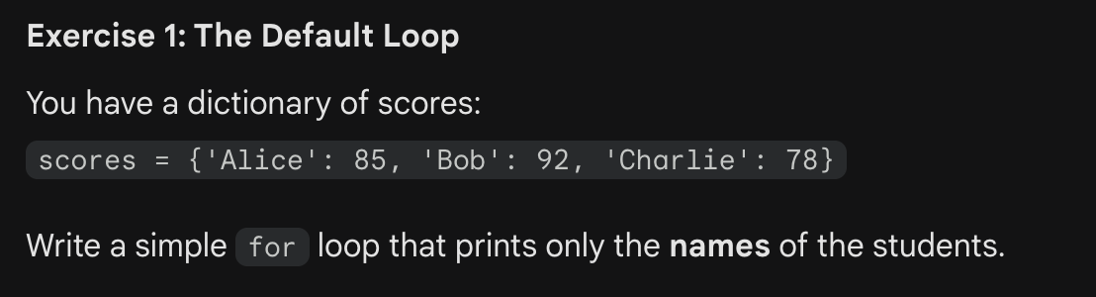
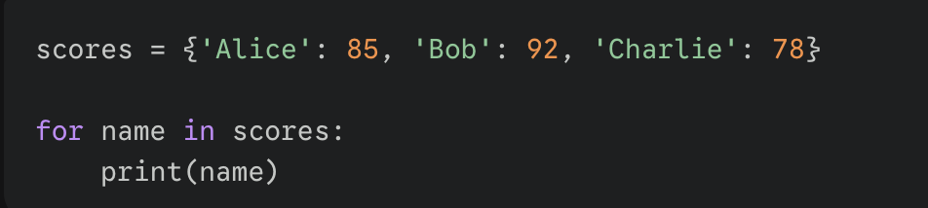
scores = {'Alice': 85, 'Bob': 92, 'Charlie': 78}

Slide 20
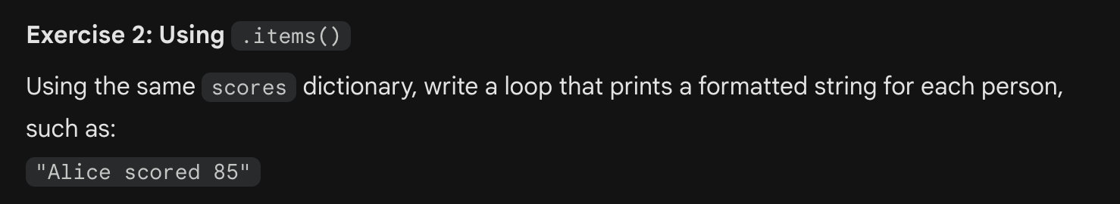
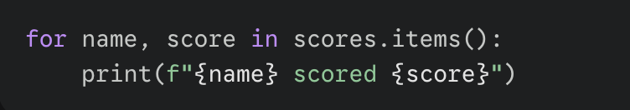

Slide 21
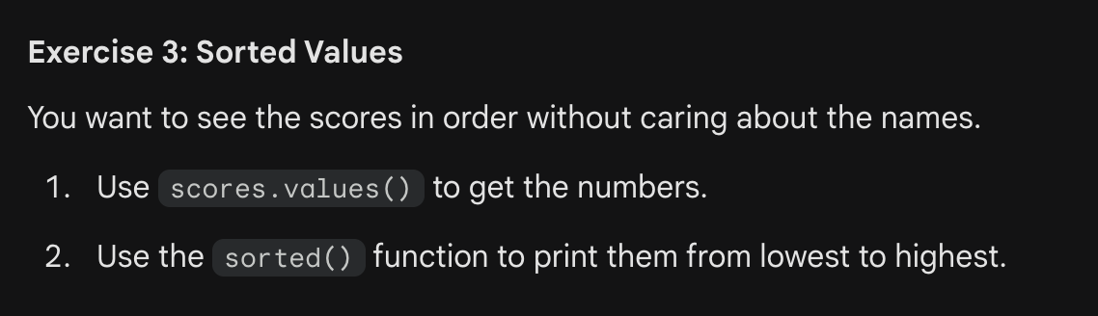
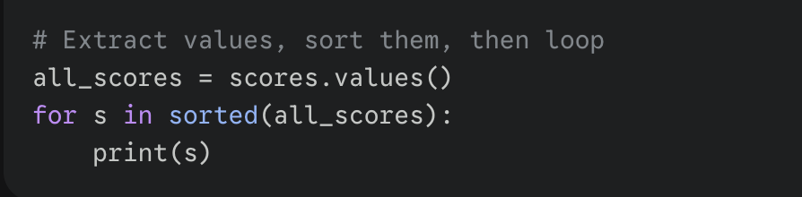

Slide 22
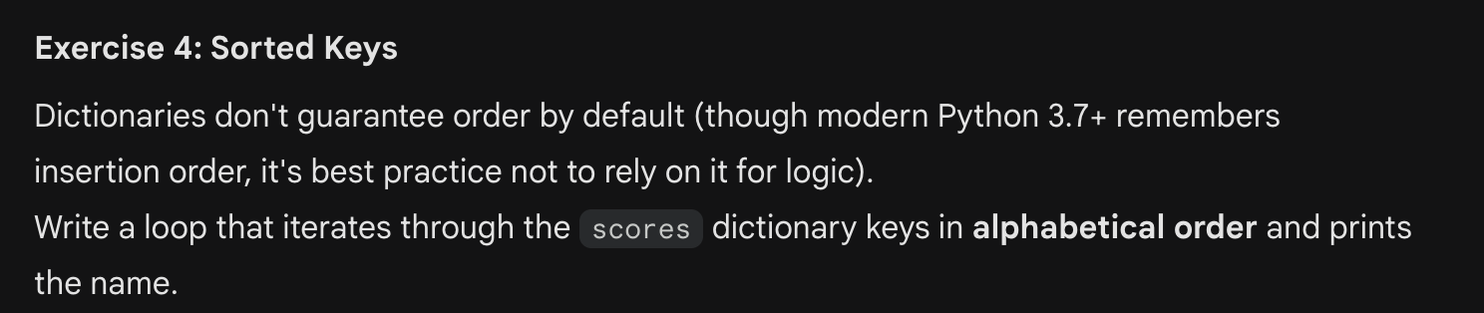
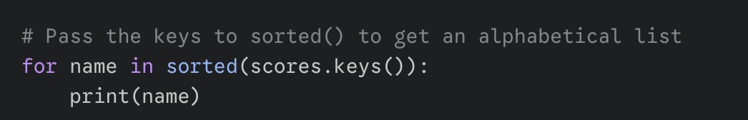

Slide 23
Using Dictionaries as a Practical Data-Organization Strategy
• From a performance perspective, dictionaries are one of the most powerful everyday tools in Python because they can turn repeated searching into fast direct lookups.
◦ Often faster than scanning lists repeatedly
• A useful pattern is to store a list of related records under one key, such as grouping many log lines under the IP address that appears at the start of each line.
◦ Key: IP address
◦ Value: list of lines for that IP
• After reading and organizing all input into a dict, you can immediately retrieve everything associated with a particular key, which makes analysis and reporting much simpler.
◦ Lookups happen after data collection
◦ Supports quick investigation of a single key

Slide 24
Dict Formatting

Slide 25
Formatting Strings with Dictionary Data
• Python’s % operator supports named placeholders that pull values from a dictionary, letting you build readable messages where each placeholder refers to a key by name.
◦ Placeholders look like %(name)s
◦ %d formats integers, %s formats strings
• This dict-based formatting is helpful when you have several values to insert and you want the template text to clearly show which dictionary key supplies each value.
◦ Template becomes self-documenting
◦ Works well for logs and reports
• You can also use str.format() with named fields so that formatting rules, such as integer formatting with :d, are embedded in the string template.
◦ Named fields look like {count:d}
◦ Alternative to the % operator

Slide 26
Code Example: Formatting with % and str.format()
h = {}
h['word'] = 'garfield'
h['count'] = 42
s = 'I want %(count)d copies of %(word)s' % h # %d for int, %s for string
# 'I want 42 copies of garfield'
# You can also use str.format().
s = 'I want {count:d} copies of {word}'.format(h)

Slide 27
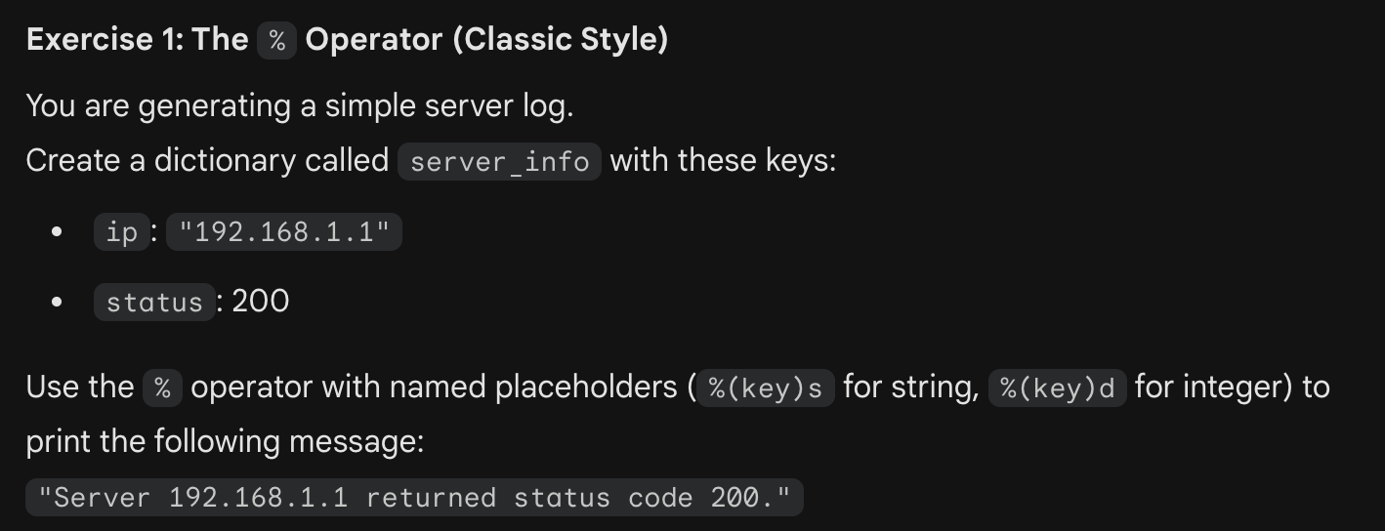
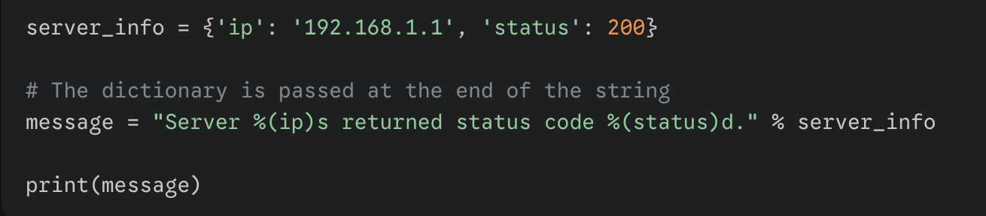

Slide 28
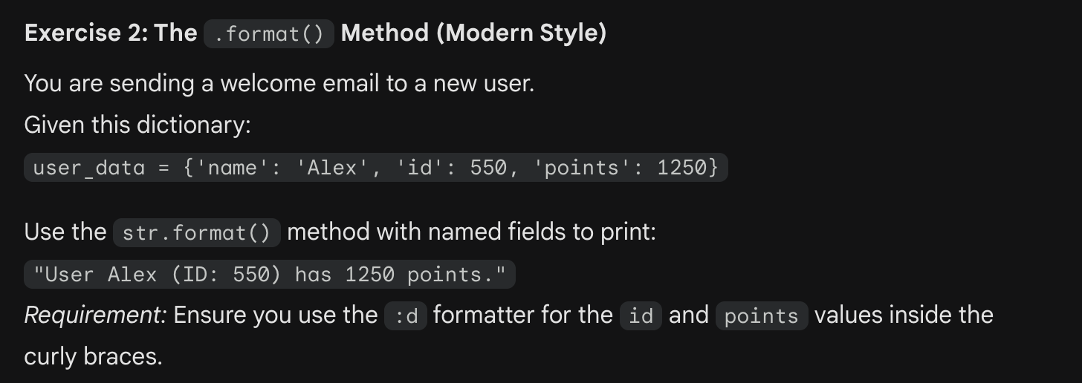
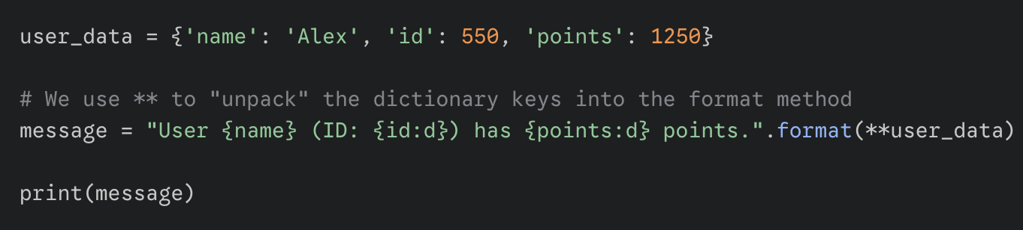
user_data = {'name': 'Alex', 'id': 550, 'points': 1250}

Slide 29
Del

Slide 30
Deleting Data with del: Variables, Lists, and Dictionaries
• The del operator removes things from your program, and when used on a variable name it deletes that binding so it behaves as if the variable was never defined.
◦ After del, the name no longer exists
• When del is applied to a list index or slice, it removes those elements and shifts the remaining elements, which permanently changes the list’s contents and length.
◦ del list[0] removes one element
◦ del list[-2:] removes a range
• When del is used with a dictionary key, it removes the entire key/value entry so that future lookups for that key will fail unless it is added back later.
◦ del d['b'] removes both key and value

Slide 31
Code Example: Using del on Variables, Lists, and Dict Entries
var = 6
del var # var no more!
list = ['a', 'b', 'c', 'd']
del list[0] ## Delete first element
del list[-2:] ## Delete last two elements
print(list) ## ['b']
dict = {'a':1, 'b':2, 'c':3}
del dict['b'] ## Delete 'b' entry
print(dict) ## {'a':1, 'c':3}

Slide 32
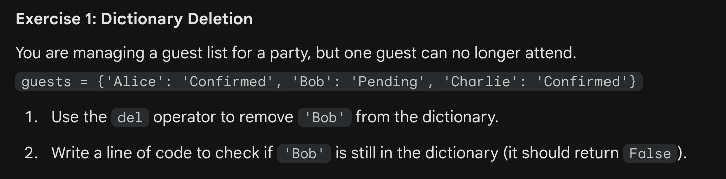
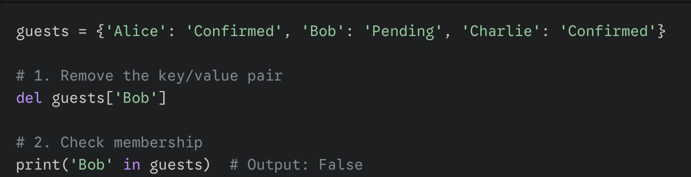
guests = {'Alice': 'Confirmed', 'Bob': 'Pending', 'Charlie': 'Confirmed'}

Slide 33
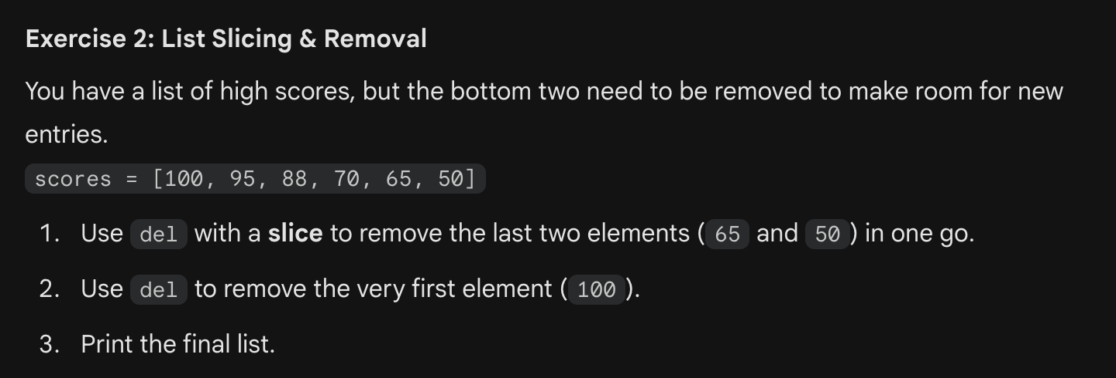
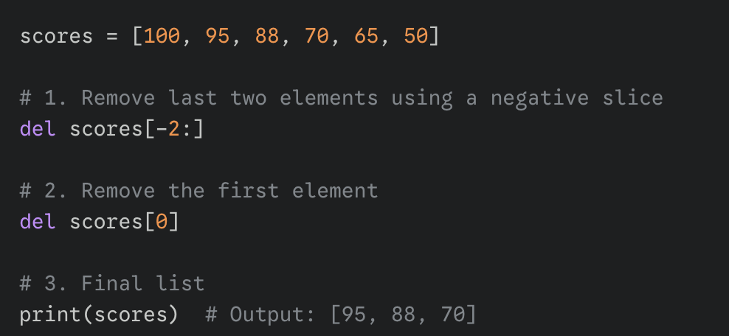
scores = [100, 95, 88, 70, 65, 50]

Slide 34
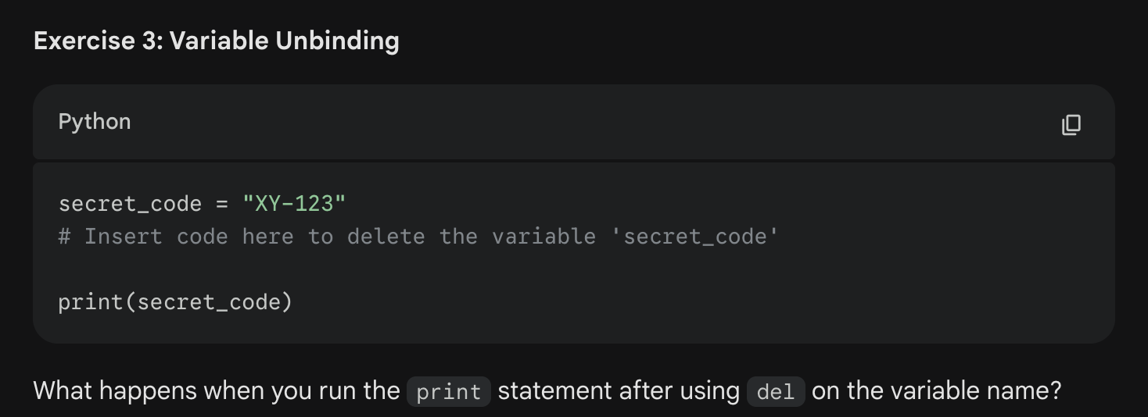
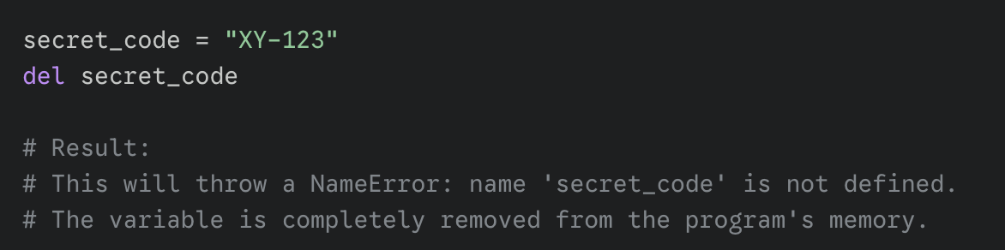

Slide 35
Files

Slide 36
Working with Files: Opening, Closing, and Reading Lines
• The open() function returns a file handle you can use to read or write a file, and you should close it when finished so resources are released promptly.
◦ Common pattern: f = open(...); f.close()
• The mode argument selects the file operation, using 'r' for reading, 'w' for writing, and 'a' for appending, with text modes often written as 'rt' or 'wt'.
◦ r = read, w = write, a = append
◦ t indicates text mode
• For text files, a for loop can iterate line by line, which is simple and efficient because it processes one line at a time rather than loading everything into memory.
◦ Works for text files, not binary files
◦ Each line includes its newline character

Slide 37
Code Example: Echoing a Text File Line by Line
# Echo the contents of a text file
f = open('foo.txt', 'rt', encoding='utf-8')
for line in f: ## iterates over the lines of the file
print(line, end='') ## end='' so print does not add an end-of-line char
## since 'line' already includes the end-of-line.
f.close()

Slide 38
Reading File Contents: Streaming vs Loading Everything
• Reading one line at a time is memory-friendly because you can process extremely large files, such as multi-gigabyte logs, without needing enough RAM to hold them fully.
◦ Streaming processing scales to large files
• The method f.readlines() reads the entire file into memory as a list of lines, which can be convenient but may be inappropriate for large files.
◦ Returns a list, one string per line
• The method f.read() reads the entire file into a single string, which is useful when you want to analyze the text as a whole, such as with later pattern-matching tools.
◦ Returns one big string
◦ Convenient for whole-text operations

Slide 39
Writing File Contents
• To write output, you can call f.write(string) directly, or you can use print(string, file=f) to send formatted text to the file with print’s normal conveniences.
◦ f.write does not add a newline automatically
◦ print typically adds a newline unless configured

Slide 40
Files Unicode

Slide 41
Unicode Text Files: Encodings and Context Managers
• When reading or writing Unicode text, open the file in text mode and specify an explicit encoding like utf-8 so Python decodes bytes into correct characters reliably.
◦ Use mode containing 't'
◦ encoding='utf-8' is a common choice
• Using with open(...) as f automatically closes the file even if an error occurs, which reduces bugs caused by forgetting to call close() in every execution path.
◦ Also called a context manager
◦ Safer than manual close in many cases
• When you read lines in text mode with an encoding, each line you get is a Unicode string in Python, which means it can represent characters beyond plain ASCII.
◦ Supports symbols like € and non-Latin scripts

Slide 42
Code Example: Reading and Writing UTF-8 Unicode Text
• with open('foo.txt', 'rt', encoding='utf-8') as f:
for line in f:
# here line is a *unicode* string
with open('write_test', encoding='utf-8', mode='wt') as f:
f.write('\\u20ACunicode\\u20AC\\n') # €unicode€
# AKA print('\\u20ACunicode\\u20AC', file=f) ## which auto-adds end='\\n'

Slide 43
Incremental Development

Slide 44
Incremental Development: Building Programs in Small Working Steps
• Instead of writing an entire program at once, start by defining a first milestone that produces a small but meaningful result, such as extracting a list of words.
◦ Pick one concrete intermediate output
◦ Make it run successfully before adding more
• After reaching a milestone, print the data structures you have built so far, because seeing real intermediate values helps you decide what transformations are needed next.
◦ Print lists, dicts, and tuples
◦ Use real sample inputs
• If later parts of the program are not ready, you can stop early using sys.exit(0), which prevents unfinished code from running and lets you focus on one piece at a time.
◦ Exit deliberately after debugging output
◦ Remove or move the exit for the next milestone
• Python encourages this step-by-step approach because it is fast to make a small change and re-run, so you can steadily improve correctness without feeling overwhelmed.
◦ Short edit-run cycles
◦ Lower risk of complex bugs

Slide 45
Practice Integration: The wordcount.py Exercise
• A word-count program is a useful practice project because it combines strings, lists, dictionaries, tuples, and file processing into a single workflow that mirrors real tasks.
◦ Reads text input
◦ Transforms and aggregates data
• A typical approach is to read the file line by line, split each line into words, and update a dictionary that maps each word to the number of times it appears.
◦ Key: a word
◦ Value: count integer
• When printing results, you can iterate over dict.items() to access words and counts together, and use sorted() to produce stable output that is easier to read and verify.
◦ Loop: for word, count in d.items()
◦ Sort by word or by count, depending on your goal

Slide 46
Thank you

